Slide 1

Vicki Hartley Course Project Phase 1 Delivery 1 BAN-502-801-802-803-871 merged (Summer 2024)
KEEP IT DRY
Product Evaluation &
Product Failure Prediction Analysis
Image Source https://www.cpsc.gov/Business--Manufacturing/Testing-Certification

Slide 2
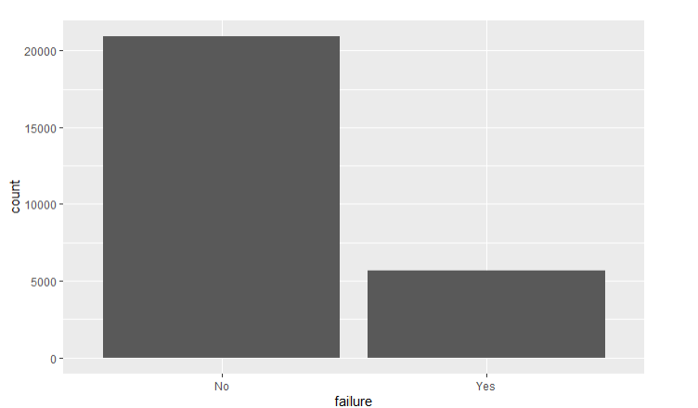
Based on the data, here are the product variables that could be predicting failure: id product_code loading attribute_0 attribute_1 attribute_2 attribute_3 measurement_0 measurement_1 measurement_2 measurement_3 measurement_4 measurement_...17 There are 26570 observations and 26 variables related to product failure.
Keep It Dry OBJECTIVE:
Predict variables may be strong predictors of the "failure" variable
On a data training review, we see that 5,100 products failed for every ~21,000. Therefore 21% of the total product fail.

Slide 3
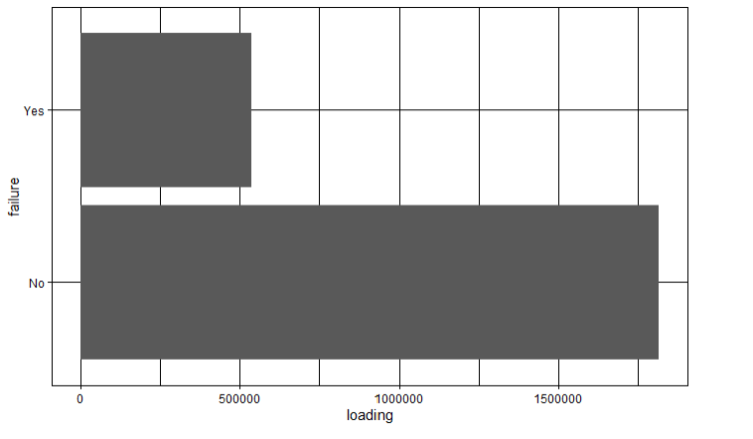
Keep It Dry
This chart tells us that there could be a positive relationship between product loading and failure so as product loading increased (especially above 500,000) product failure is more likely to occur.

Slide 4
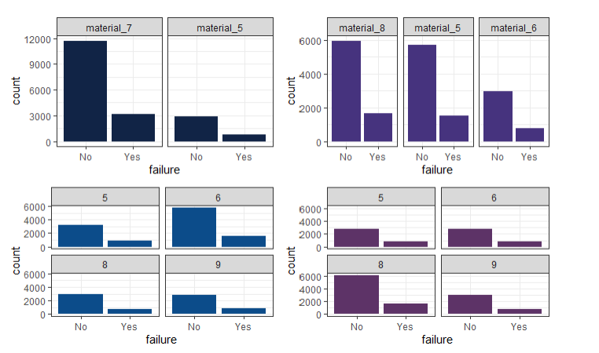
Keep It Dry
Overall, the product attributes show varying degrees in their relationship to failure.
However, attributes 2 and 3 show a closer relationship to product failure and could be good predictors of failure.
attribute_0
attribute_1
attribute_2
attribute_3

Slide 5
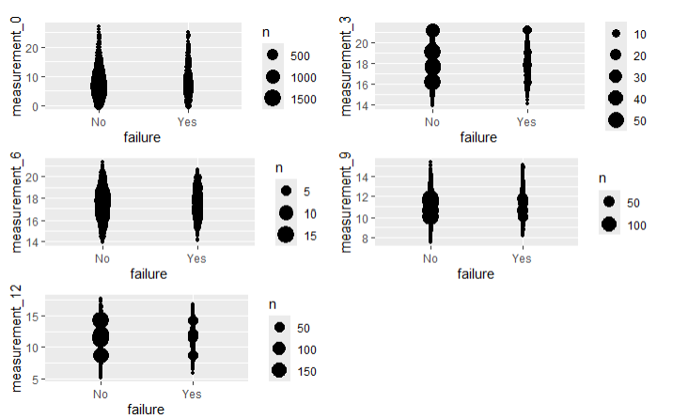
Keep It Dry
Overall, a random sampling of Measurements show that there may not be a strong distinction between product failures and non-failures based on these measurements alone.

Slide 6
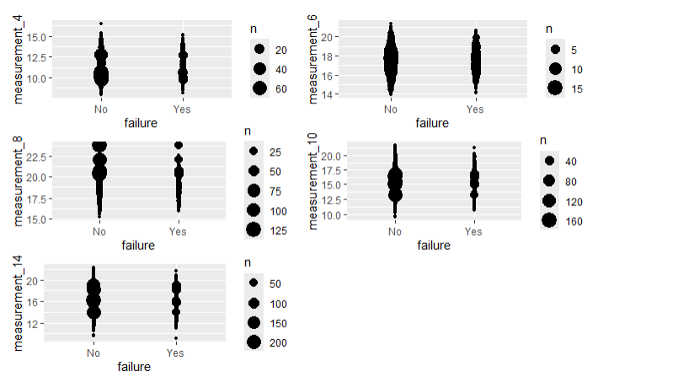
Keep It Dry
The same conclusion can be drawn from another random sampling of Measurements therefore Measurements do not appear to be a good indication of product failure.

Slide 7
Keep It Dry OBJECTIVE:
Predict variables may be strong predictors of the "failure" variable
Overall, the best indicators of product failure appear to be:
Loading (particularly above 500,000)
Attribute 2
Attribute 3
The recommendation is to:
keep loading below 500,000
better understand “5” “8” and “9” of attribute 2
better understand “5” “6” and “9” of attribute 3

